Slide 1


Support Vector Machines
12
PART III · SUPERVISED LEARNING ALGORITHMS
CHAPTER 12 · WEEK 10
Machine Learning — From Hypotheses to Decisions
LECTURER
Dr. Mustafa Hameed
THE ISLAMIA UNIVERSITY OF BAHAWALPUR
Bahawalpur, Pakistan
Department of Information Technology · BSIT · Fall 2026
Notes:
Chapter 12: Support Vector Machines. Part 3 — Supervised Learning Algorithms. Week 10: Nearest neighbours; support vector machines. Handout pages 89–94.

Slide 2

Where this chapter sits
THE COURSE
PART I
PART II
PART III
PART IV
PART V
PART VI
1
2
3
4
5
6
7
8
9
10
11
12
13
14
15
16
17
18
19
20
21
22
Support Vector Machines
BUILDS ON
USED LATER IN
Ch 2 Mathematics for Machine Learning
Ch 14 Ensemble Learning
Ch 6 Logistic Regression
Ch 7 Overfitting, Bias–Variance and Regularisation
Machine Learning · Chapter 12 · Support Vector Machines
Handout p. 89 2
Notes:
Place the chapter. Before you start: Chapter 2 (dot products, norms), Chapter 6 (linear decision boundaries, the loss view of classification) and Chapter 7 (regularisation and tuning by cross-validation).

Slide 3

What you will be able to do
LEARNING OUTCOMES
By the end of this chapter you will be able to:
1
Explain why the maximum-margin hyperplane is preferred among all separating hyperplanes, and identify its support vectors.
2
Compute the margin of a linear SVM and classify a point with its decision function.
3
Describe the soft-margin SVM and the role of C, and compute the hinge loss.
4
Explain the kernel trick, and verify a polynomial kernel against its explicit feature map.
5
Tune C and the RBF width γ by cross-validation.
Machine Learning · Chapter 12 · Support Vector Machines
Handout p. 89 3
Notes:
Read these out: they are the chapter's contract with the room. Each click adds one.

Slide 4

Vocabulary for this chapter
KEY TERMS
separating hyperplane
margin
maximum-margin classifier
support vectors
hard margin
soft margin
slack variable
C
hinge loss
dual form
feature map
kernel trick
polynomial kernel
RBF kernel
γ
support vector regression
Each term is defined where it first matters — not here.
Machine Learning · Chapter 12 · Support Vector Machines
Handout p. 89 4
Notes:
Do not define these now; they arrive one at a time. This slide is for the students' notes. Terms: separating hyperplane; margin; maximum-margin classifier; support vectors; hard margin; soft margin; slack variable; C; hinge loss; dual form; feature map; kernel trick; polynomial kernel; RBF kernel; γ; support vector regression.

Slide 5

In this chapter
IN THIS CHAPTER
12.1
Which Line?
p. 89 ›
12.2
The Maximum-Margin Hyperplane
p. 89 ›
12.3
Soft Margins and the Hinge Loss
p. 90 ›
12.4
The Kernel Trick
p. 91 ›
12.5
Practicalities
p. 93 ›
Machine Learning · Chapter 12 · Support Vector Machines
Handout pp. 89–94 5
Notes:
The route through the chapter. Each row is a link: click it to jump to that section in the slide show.

Slide 6

Which Line?
KEY IDEA
When two classes can be separated by a straight line, they can usually be separated by infinitely many. Logistic regression picks the one that maximises likelihood; the perceptron of Chapter 13 picks whichever it reaches first. A support vector machine picks the line that stays as far as possible from the nearest examples of both classes — the one with the widest margin. The intuition is that a boundary with room to spare on both sides is the least likely to be crossed by small perturbations of new data, and the theory agrees: a wider margin gives a tighter bound on the error on unseen data, regardless of the number of features.
Machine Learning · Chapter 12 · Support Vector Machines
§12.1 · Handout p. 89 6
Notes:
Say this in your own words first; the slide is the handout's wording.

Slide 7
The Maximum-Margin Hyperplane
SECTION 2 OF 5
12.2
12.1 Which Line?
12.2 The Maximum-Margin Hyperplane
12.3 Soft Margins and the Hinge Loss
12.4 The Kernel Trick
12.5 Practicalities
Machine Learning · Chapter 12
Handout §12.2 7
Notes:
Pause. Name the question this section answers.

Slide 8

Hyperplane, Margin and Support Vectors
DEFINITION
A linear classifier predicts sign(w·x + b) with labels y ∈ {−1, +1}. The distance of a point x from the hyperplane w·x + b = 0 is |w·x + b| / ‖w‖. Scale w and b so that the closest points satisfy y_{i}(w·x_{i} + b) = 1; then the margin — the width of the empty band between the classes — is 2/‖w‖. The hard-margin SVM solves
The training points that lie exactly on the edges of the band are the support vectors. They alone determine the solution: every other point could be moved or deleted, as long as it stayed outside the band, and the hyperplane would not change.
Machine Learning · Chapter 12 · Support Vector Machines
§12.2 · Handout p. 89 8
Notes:
Read the box aloud, then ask for an example from the room before moving on.

Slide 9
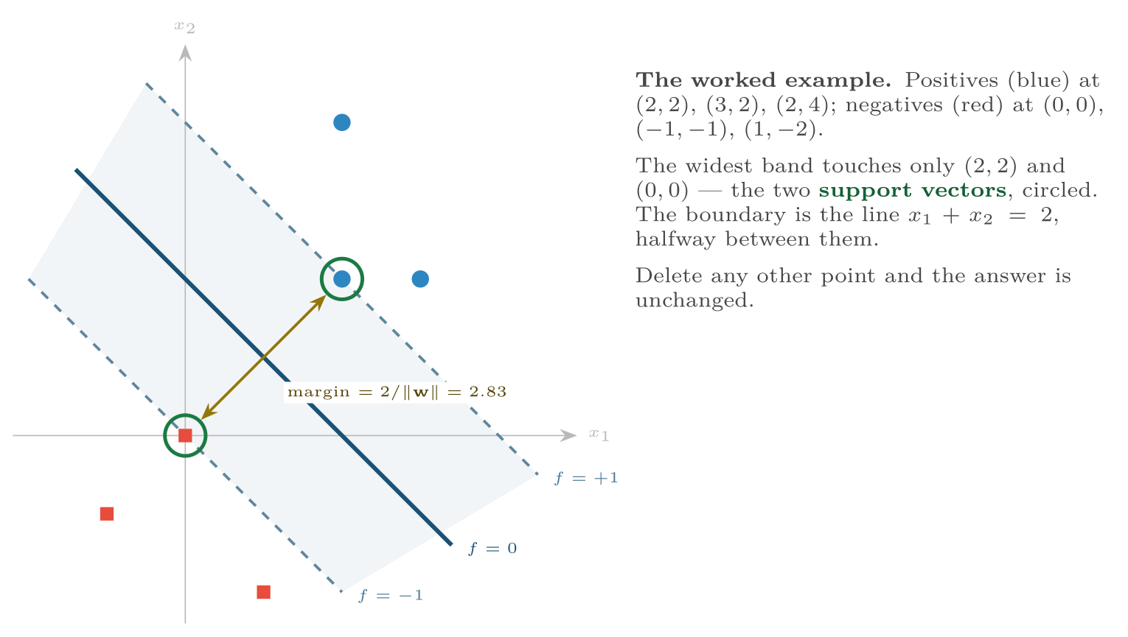
The maximum-margin hyperplane
FIGURE 12.1
The solid line separates the classes; the dashed lines bound the widest empty band; the points on the dashed lines are the support vectors.
Machine Learning · Chapter 12 · Support Vector Machines
§12.2 · Handout p. 89 9
Notes:
Figure 12.1 (handout p. 90): The maximum-margin hyperplane. The solid line separates the classes; the dashed lines bound the widest empty band; the points on the dashed lines are the support vectors.

Slide 10

A Maximum-Margin Line by Hand
WORKED EXAMPLE
The six points of Figure 12.1. The closest opposite-class pair is (2,2) and (0,0), so the boundary is perpendicular to the segment between them: w = a (1, 1) for some a > 0.
Canonical scaling. Put the support vectors exactly on the margins:
So b = −1, a = 0.5: w = (0.5, 0.5). The boundary is 0.5x₁ + 0.5x₂ − 1 = 0, i.e. x₁ + x₂ = 2.
Margin: ‖w‖ = √(0.25 + 0.25) = 0.707, so 2/‖w‖ = 2.83 — exactly the distance from (0,0) to (2,2).
Check the constraints: (3,2): f = 1.5 ≥ 1; (2,4): f = 2 ≥ 1; (−1,−1): f = −2 ≤ −1; (1,−2): f = −1.5 ≤ −1. All satisfied.
Classify (1.5, 1): f = 0.75 + 0.5 − 1 = 0.25 > 0, so positive, at distance 0.25/0.707 = 0.35 from the boundary — inside the margin band, so a point the SVM is not confident about. scikit-learn’s SVC returns the same w, b and support vectors (this chapter’s lab).
Machine Learning · Chapter 12 · Support Vector Machines
§12.2 · Handout p. 89 10
Notes:
Each click adds one step of the working. Ask for the next number before you reveal it.

Slide 11
Soft Margins and the Hinge Loss
SECTION 3 OF 5
12.3
12.1 Which Line?
12.2 The Maximum-Margin Hyperplane
12.3 Soft Margins and the Hinge Loss
12.4 The Kernel Trick
12.5 Practicalities
Machine Learning · Chapter 12
Handout §12.3 11
Notes:
Pause. Name the question this section answers.

Slide 12
Soft Margins and the Hinge Loss
IN BRIEF
Real data is rarely separable, and even when it is, one mislabelled point can drag the hard-margin boundary into a bad place. The soft-margin SVM lets points violate the margin at a price. Each point gets a slack variable ξ_{i} ≥ 0 measuring how far it is on the wrong side of its margin:
Machine Learning · Chapter 12 · Support Vector Machines
§12.3 · Handout p. 90 12
Notes:
Real data is rarely separable, and even when it is, one mislabelled point can drag the hard-margin boundary into a bad place. The soft-margin SVM lets points violate the margin at a price. Each point gets a slack variable ξi ≥ 0 measuring how far it is on the wrong side of its margin:

Slide 13

The Hinge Loss
DEFINITION
At the optimum each slack equals max(0, 1 − y_{i} f(x_{i})), so the soft-margin SVM is equivalent to minimising
— a loss plus an L2 penalty, the same shape as regularised logistic regression with the cross-entropy replaced by the hinge. Points beyond the margin on the correct side cost nothing.
Machine Learning · Chapter 12 · Support Vector Machines
§12.3 · Handout p. 90 13
Notes:
The hyperparameter C sets the price. A large C punishes every violation heavily: narrow margin, few violations, high variance. A small C tolerates violations to buy a wider margin: more bias, less variance. C is the SVM’s regularisation knob, and it is tuned by cross-validation.

Slide 14
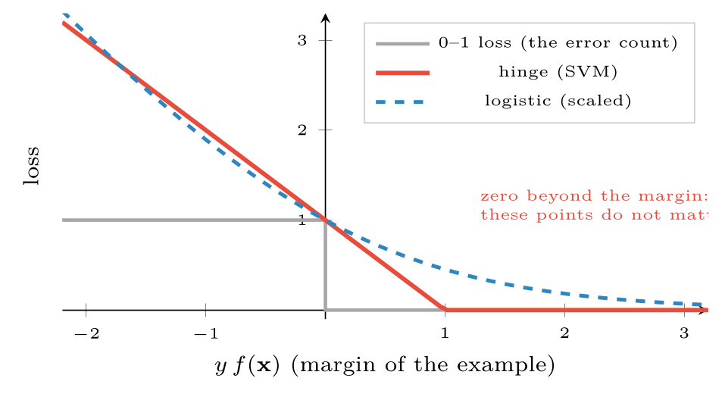
Three losses as a function of y f(x), positive when the example is correctly classified
FIGURE 12.2
The hinge is exactly zero for points beyond the margin, which is why only support vectors affect the SVM; the logistic loss is never quite zero.
Machine Learning · Chapter 12 · Support Vector Machines
§12.3 · Handout p. 90 14
Notes:
Figure 12.2 (handout p. 91): Three losses as a function of y f(x), positive when the example is correctly classified. The hinge is exactly zero for points beyond the margin, which is why only support vectors affect the SVM; the logistic loss is never quite zero.

Slide 15
Hinge Losses
WORKED EXAMPLE
Four training points have margins y f(x) = 2, 1, 0.5, −0.5:
• y f = 2: max(0, 1 − 2) = 0 — well clear; irrelevant to the solution.
• y f = 1: max(0, 0) = 0 — exactly on the margin; a support vector.
• y f = 0.5: 0.5 — correctly classified but inside the margin.
• y f = −0.5: 1.5 — misclassified.
The last three all influence the boundary; the first does not. With C large the optimiser will work hard to remove the last two losses; with C small it will accept them for a wider margin.
Machine Learning · Chapter 12 · Support Vector Machines
§12.3 · Handout p. 90 15
Notes:
Each click adds one step of the working. Ask for the next number before you reveal it.

Slide 16
The Kernel Trick
SECTION 4 OF 5
12.4
12.1 Which Line?
12.2 The Maximum-Margin Hyperplane
12.3 Soft Margins and the Hinge Loss
12.4 The Kernel Trick
12.5 Practicalities
Machine Learning · Chapter 12
Handout §12.4 16
Notes:
Pause. Name the question this section answers.

Slide 17
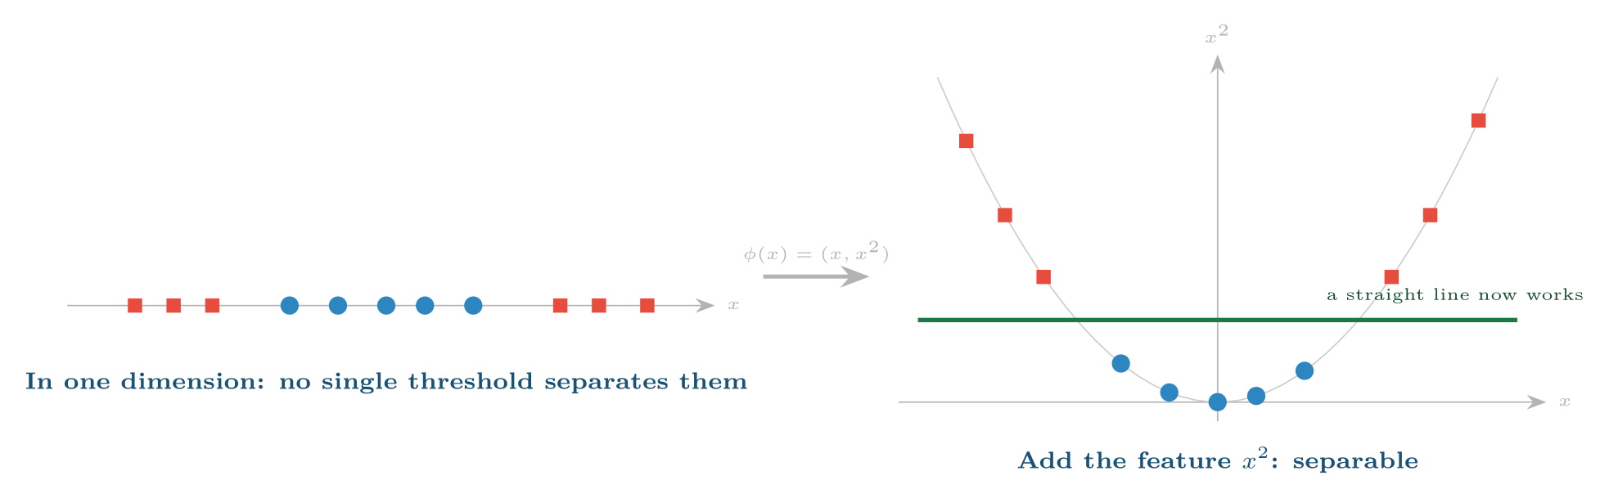
Lifting data into more dimensions
FIGURE 12.3
The inner class (blue) and the outer class (red) cannot be separated on the line, but after adding x2 as a second feature a horizontal line separates them; in the original space that line is two thresholds.
Machine Learning · Chapter 12 · Support Vector Machines
§12.4 · Handout p. 91 17
Notes:
Some problems no straight line can solve — one class surrounding another, say. The standard remedy (Chapter 5) is to add non-linear features, such as squares and products, and fit a linear model in the enlarged space. That works, but the enlarged space can be enormous: all products of pairs of 1,000 features is half a million features.
Figure 12.3 (handout p. 92): Lifting data into more dimensions. The inner class (blue) and the outer class (red) cannot be separated on the line, but after adding x2 as a second feature a horizontal line separates them; in the original space that line is two thresholds.

Slide 18
Kernel
DEFINITION
A kernel is a function K(x, z) that equals the dot product φ(x)·φ(z) in some feature space φ, but is computed without ever constructing φ. Because the SVM’s optimisation and its decision function use the data only through dot products,
replacing every dot product by a kernel fits a linear boundary in the feature space — a non-linear boundary in the original one — at the cost of computing K. This is the kernel trick. The sum runs over support vectors only: all other α_{i} are zero.
Machine Learning · Chapter 12 · Support Vector Machines
§12.4 · Handout p. 91 18
Notes:
Read the box aloud, then ask for an example from the room before moving on.

Slide 19
The Kernel Computes the Big Dot Product Cheaply
WORKED EXAMPLE
Take K(x, z) = (x·z)² in two dimensions, and x = (1, 2), z = (3, 1).
The kernel: x·z = 3 + 2 = 5, so K = 25. One dot product and one squaring.
The long way: this kernel corresponds to φ(x) = (x₁², √2 x₁ x₂, x₂²):
The same number. For degree p on d features the feature space has on the order of d^{p} dimensions; the kernel is still one dot product and one power.
Machine Learning · Chapter 12 · Support Vector Machines
§12.4 · Handout p. 91 19
Notes:
Each click adds one step of the working. Ask for the next number before you reveal it.

Slide 20

The Kernel Trick
AT A GLANCE
Kernel | K(x, z) | Use and settings
Linear | x·z | Many features, text; fast. Tune C only
Polynomial | (γ x·z + r)^{p} | Interactions of up to p features; tune p, C
RBF (Gaussian) | exp(−γ‖x − z‖²) | The default for non-linear problems. Large γ: each point’s influence is narrow, the boundary wiggles (variance). Small γ: smooth boundary (bias). Tune C and γ together
Machine Learning · Chapter 12 · Support Vector Machines
§12.4 · Handout p. 91 20
Notes:
Do not read the table row by row: pick the row the room is most likely to get wrong and ask why.

Slide 21

Scale the Features, Then Tune C and γ Together
WATCH OUT
The RBF kernel is a function of distance, so everything said about scaling in Chapter 11 applies. And C and γ interact — a larger γ often wants a smaller C — so search them as a grid, on a logarithmic scale (C in {0.1, 1, 10, 100}, gamma in {0.001, 0.01, 0.1, 1}), by cross-validation. On the 600 projects of Chapter 11’s lab this finds C = 100, γ = 0.01 and 93.2% accuracy — better than the best k-NN — using 183 of the projects as support vectors. C landed on the edge of the grid, so the next step would be to extend the grid upwards.
Machine Learning · Chapter 12 · Support Vector Machines
§12.4 · Handout p. 91 21
Notes:
Read the box aloud, then ask for an example from the room before moving on.

Slide 22

Common pitfalls
COMMON PITFALLS
✕
Not scaling features. The RBF kernel and the margin are both distances.
✕
Tuning C and γ separately. They interact; use a grid.
✕
Using a huge C on noisy data. The hard margin chases every mislabelled point.
✕
Reading f(x) as a probability. It is a signed distance; calibrate if probabilities are needed.
✕
Running a kernel SVM on a million rows. Use a linear SVM, or a different model.
Machine Learning · Chapter 12 · Support Vector Machines
§12.5 · Handout p. 93 22
Notes:
For each pitfall, ask who has seen it happen. One real story beats five bullets.

Slide 23

Try it yourself: Margins, Kernels and a Tuning Grid
TRY IT YOURSELF
WHAT YOU WILL DO
1. The worked example: a maximum-margin line
2. A problem no line can solve
3. Tune C and gamma together, features scaled
THIS WEEK'S LAB
WHAT YOU WILL RUN
RUNNABLE COPY
Week 10: Neighbours, scaling and k; margins and kernels
1 listing, 41 lines of Python
code/ch12_margins_kernels_tuning.py
Machine Learning · Chapter 12 · Support Vector Machines
§12.5 · Handout p. 93 23
Notes:
Say what the room will have at the end of the lab, then let them start. Circulate rather than lecture.

Slide 24
Margins, Kernels and a Tuning Grid
LAB · STEP 1 OF 4
Set-up
Python · code/ch12_margins_kernels_tuning.py
2
3
4
5
6
7
import numpy as np
from sklearn.svm import SVC
from sklearn.datasets import make_circles
from sklearn.model_selection import cross_val_score, GridSearchCV
from sklearn.pipeline import make_pipeline
from sklearn.preprocessing import StandardScaler
Machine Learning · Chapter 12 · Support Vector Machines
§12.5 · Handout p. 93 24
Notes:
Step 1: Set-up. Read the code aloud; ask what each line would print before running it.

Slide 25
Margins, Kernels and a Tuning Grid
LAB · STEP 2 OF 4
The worked example: a maximum-margin line
Python · code/ch12_margins_kernels_tuning.py
9
10
11
12
13
14
15
16
17
# --- 1. the worked example: a maximum-margin line ------------------------
X = np.array([[2, 2], [3, 2], [2, 4], [0, 0], [-1, -1], [1, -2]])
y = np.array([1, 1, 1, -1, -1, -1])
svm = SVC(kernel="linear", C=1e6).fit(X, y) # huge C = hard margin
w, b = svm.coef_[0], svm.intercept_[0]
print("w =", w.round(3), " b =", round(b, 3))
print("margin width 2/||w|| =", round(2 / np.linalg.norm(w), 3))
print("support vectors:", svm.support_vectors_.tolist())
print("f(1.5, 1) =", round(float(svm.decision_function([[1.5, 1]])[0]), 3))
Machine Learning · Chapter 12 · Support Vector Machines
§12.5 · Handout p. 93 25
Notes:
Step 2: The worked example: a maximum-margin line. Read the code aloud; ask what each line would print before running it.

Slide 26
Margins, Kernels and a Tuning Grid
LAB · STEP 3 OF 4
A problem no line can solve
Python · code/ch12_margins_kernels_tuning.py
19
20
21
22
23
# --- 2. a problem no line can solve --------------------------------------
Xc, yc = make_circles(n_samples=400, noise=0.08, factor=0.4, random_state=0)
for kernel in ("linear", "poly", "rbf"):
acc = cross_val_score(SVC(kernel=kernel, degree=2), Xc, yc, cv=5).mean()
print(f"circles, {kernel:6s} kernel: accuracy {acc:.3f}")
Machine Learning · Chapter 12 · Support Vector Machines
§12.5 · Handout p. 93 26
Notes:
Step 3: A problem no line can solve. Read the code aloud; ask what each line would print before running it.

Slide 27
Margins, Kernels and a Tuning Grid
LAB · STEP 4 OF 4
Tune C and gamma together, features scaled
Python · code/ch12_margins_kernels_tuning.py
25
26
27
28
29
30
31
32
33
34
35
36
37
38
39
40
41
42
# --- 3. tune C and gamma together, features scaled -----------------------
rng = np.random.default_rng(11) # the projects of Chapter 11
n = 600
Xb = np.column_stack([rng.uniform(20, 100, n), # requirement stability
rng.uniform(20, 100, n), # team experience
rng.uniform(50, 2000, n), # budget, thousand USD
rng.uniform(4, 52, n)]) # planned weeks
yb = (Xb[:, 0] * Xb[:, 1] < 2500).astype(int) # 1 = late
flip = rng.random(n) < 0.05
yb[flip] = 1 - yb[flip]
pipe = make_pipeline(StandardScaler(), SVC(kernel="rbf"))
grid = GridSearchCV(pipe, {"svc__C": [0.1, 1, 10, 100],
"svc__gamma": [0.001, 0.01, 0.1, 1]}, cv=5)
grid.fit(Xb, yb)
print("best:", grid.best_params_, "CV accuracy",
round(grid.best_score_, 3))
print("support vectors used:", grid.best_estimator_[-1].n_support_.sum(),
"of", len(yb))
Machine Learning · Chapter 12 · Support Vector Machines
§12.5 · Handout p. 93 27
Notes:
Step 4: Tune C and gamma together, features scaled. Read the code aloud; ask what each line would print before running it.

Slide 28
What the lab shows
TRY IT YOURSELF
In part 1, add the point (1, 1.5) with label +1 and rerun. It lies inside the old margin: which support vectors change, and what happens to the margin width?
Machine Learning · Chapter 12 · Support Vector Machines
§12.5 · Handout p. 93 28
Notes:
Read the box aloud, then ask for an example from the room before moving on.

Slide 29

A linear SVM has w = (3, 4) and b = −5. What is its margin width, and how is (1, 1) classified?
CHECKPOINT 1 OF 3
Discuss with the person next to you, then advance.
Machine Learning · Chapter 12 · Support Vector Machines
Handout p. 94 · answers in Appendix D 29
Notes:
Ask the room. Do not advance until someone commits to an answer.

Slide 30

A linear SVM has w = (3, 4) and b = −5. What is its margin width, and how is (1, 1) classified?
CHECKPOINT 1 OF 3 · ANSWER
‖w‖ = 5, so the margin is 2/5 = 0.4. f(1, 1) = 3 + 4 − 5 = 2 > 0: positive.
Machine Learning · Chapter 12 · Support Vector Machines
Handout p. 94 · answers in Appendix D 30
Notes:
Answer (Appendix D): ‖w‖ = 5, so the margin is 2/5 = 0.4. f(1, 1) = 3 + 4 − 5 = 2 > 0: positive.

Slide 31
What happens to the margin and to training errors as C is increased?
CHECKPOINT 2 OF 3
Discuss with the person next to you, then advance.
Machine Learning · Chapter 12 · Support Vector Machines
Handout p. 94 · answers in Appendix D 31
Notes:
Ask the room. Do not advance until someone commits to an answer.

Slide 32
What happens to the margin and to training errors as C is increased?
CHECKPOINT 2 OF 3 · ANSWER
The margin narrows and the model tolerates fewer violations, so training errors fall — and the risk of overfitting rises.
Machine Learning · Chapter 12 · Support Vector Machines
Handout p. 94 · answers in Appendix D 32
Notes:
Answer (Appendix D): The margin narrows and the model tolerates fewer violations, so training errors fall — and the risk of overfitting rises.

Slide 33
Why can the kernel trick be applied to the SVM at all?
CHECKPOINT 3 OF 3
Discuss with the person next to you, then advance.
Machine Learning · Chapter 12 · Support Vector Machines
Handout p. 94 · answers in Appendix D 33
Notes:
Ask the room. Do not advance until someone commits to an answer.

Slide 34
Why can the kernel trick be applied to the SVM at all?
CHECKPOINT 3 OF 3 · ANSWER
Because both the SVM’s optimisation and its decision function use the training examples only through dot products x_{i} · x_{j}, and each dot product can be replaced by a kernel.
Machine Learning · Chapter 12 · Support Vector Machines
Handout p. 94 · answers in Appendix D 34
Notes:
Answer (Appendix D): Because both the SVM’s optimisation and its decision function use the training examples only through dot products xi · xj, and each dot product can be replaced by a kernel.

Slide 35

What to take away
CHAPTER SUMMARY
1
Of all separating hyperplanes the SVM chooses the one with the widest margin, 2/‖w‖; it is determined by the support vectors alone.
2
The soft-margin SVM allows violations priced by C, and is equivalent to hinge loss plus an L2 penalty. Large C: narrow margin, high variance.
3
The hinge loss is zero beyond the margin, which is why only support vectors matter.
4
Kernels compute dot products in a large feature space without building it; the RBF kernel is the default for non-linear problems.
5
Scale the features and tune C and γ together on a logarithmic grid by cross-validation.
Machine Learning · Chapter 12 · Support Vector Machines
Handout p. 94 35
Notes:
Ask the room to say each takeaway before you reveal it.

Slide 36

Quick check 1 of 3
REVIEW · MULTIPLE CHOICE
The support vectors of an SVM are:
A
all training points
B
the points on or inside the margin
C
the misclassified points only
D
the cluster centres
Machine Learning · Chapter 12 · Support Vector Machines
Handout p. 94 36
Notes:
Take a show of hands for each option before discussing. (The handout does not print MCQ answers.)

Slide 37
Quick check 2 of 3
REVIEW · MULTIPLE CHOICE
With the RBF kernel, a very large γ tends to:
A
underfit
B
overfit
C
have no effect
D
make the model linear
Machine Learning · Chapter 12 · Support Vector Machines
Handout p. 94 37
Notes:
Take a show of hands for each option before discussing. (The handout does not print MCQ answers.)

Slide 38
Quick check 3 of 3
REVIEW · MULTIPLE CHOICE
The hinge loss of a point with y f(x) = 0.3 is:
A
0
B
0.3
C
0.7
D
1.3
Machine Learning · Chapter 12 · Support Vector Machines
Handout p. 94 38
Notes:
Take a show of hands for each option before discussing. (The handout does not print MCQ answers.)

Slide 39
For your notebook
REVIEW QUESTIONS
SHORT
Why is a wider margin expected to generalise better?
SHORT
Compare the hinge loss with the logistic loss.
SHORT
Explain the kernel trick without formulas.
APPLIED
For support vectors (1, 3) (label +1) and (1, 1) (label −1), find w, b and the margin of the maximum-margin line, and classify (4, 2.5).
APPLIED
Verify that K(x, z) = (x·z)² equals φ(x)·φ(z) for x = (2, −1) and z = (1, 3).
Machine Learning · Chapter 12 · Support Vector Machines
Handout p. 94 39
Notes:
Set these for independent study. Model answers are not printed in the handout.

Slide 40
Practicalities
KEY IDEA
More than two classes. The SVM is inherently binary. scikit-learn’s SVC trains one classifier per pair of classes (one-vs-one) and lets them vote; LinearSVC uses one-vs-rest.
Probabilities. The decision function f(x) is a distance, not a probability. SVC(probability=True) fits a sigmoid to it afterwards (Platt scaling), at extra cost.
Scale of data. Training cost grows between the square and the cube of the number of examples, so kernel SVMs suit datasets of up to tens of thousands of rows. Linear SVMs scale to millions.
Regression. Support vector regression ignores errors smaller than a tube of width ε around the prediction and charges linearly beyond it — the regression counterpart of the hinge.
Inductive bias. Among the hypotheses consistent with the data (up to the slack allowed), prefer the one with the largest margin.
Machine Learning · Chapter 12 · Support Vector Machines
§12.5 · Handout p. 93 40
Notes:
Say this in your own words first; the slide is the handout's wording.

Slide 41
End of Chapter 12
12
NEXT
READ
Chapter 13 — Artificial Neural Networks
Handout Chapter 12, pages 89–94
THIS WEEK'S LAB
ASSESSMENT
Neighbours, scaling and k; margins and kernels
Assignment 2 set
Machine Learning · Chapter 12 · Support Vector Machines
41
Notes:
Close. NEXT: Chapter 13 — Artificial Neural Networks. READ: Handout Chapter 12, pages 89–94. THIS WEEK'S LAB: Neighbours, scaling and k; margins and kernels. ASSESSMENT: Assignment 2 set.

